Slide 1

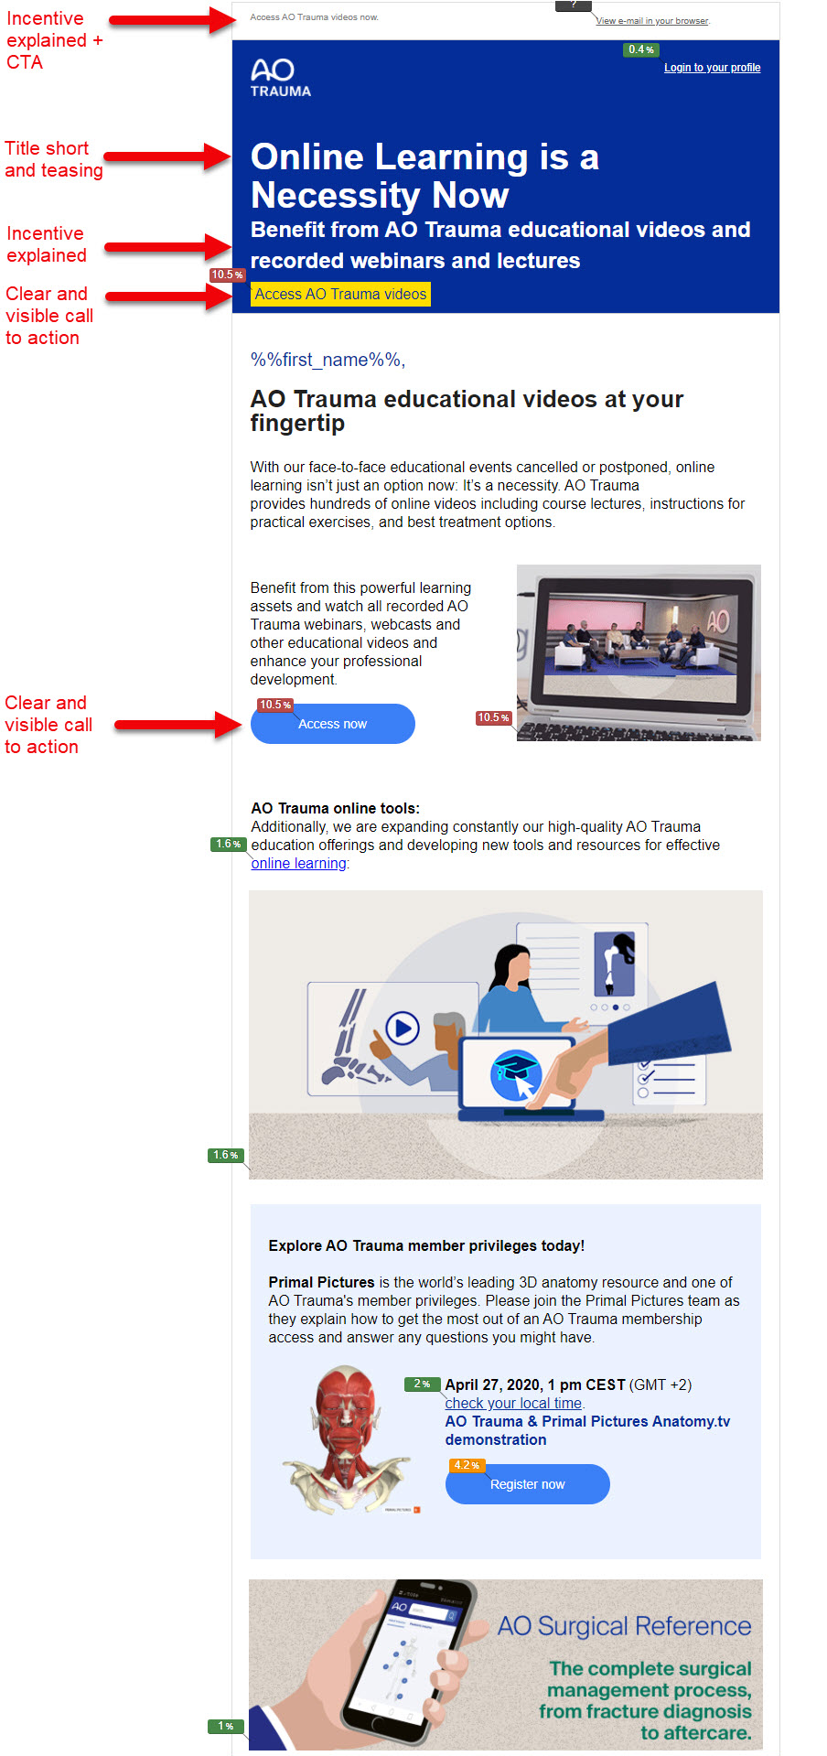
E-mail best practice
AO Trauma event promotion portal
Successful e-mail examples

Slide 2
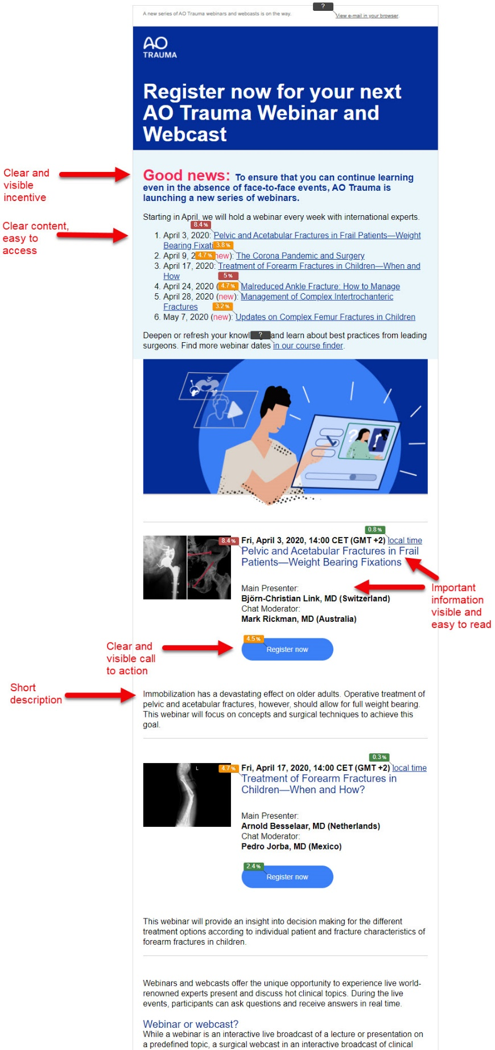
E-mail best practice
AO Trauma event promotion portal
Successful e-mail examples

Slide 3
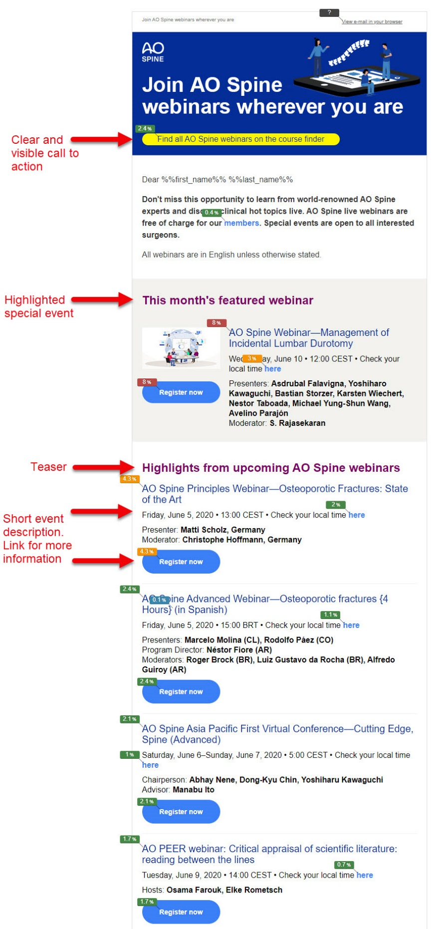
E-mail best practice
AO Trauma event promotion portal
Successful e-mail examples

Slide 4
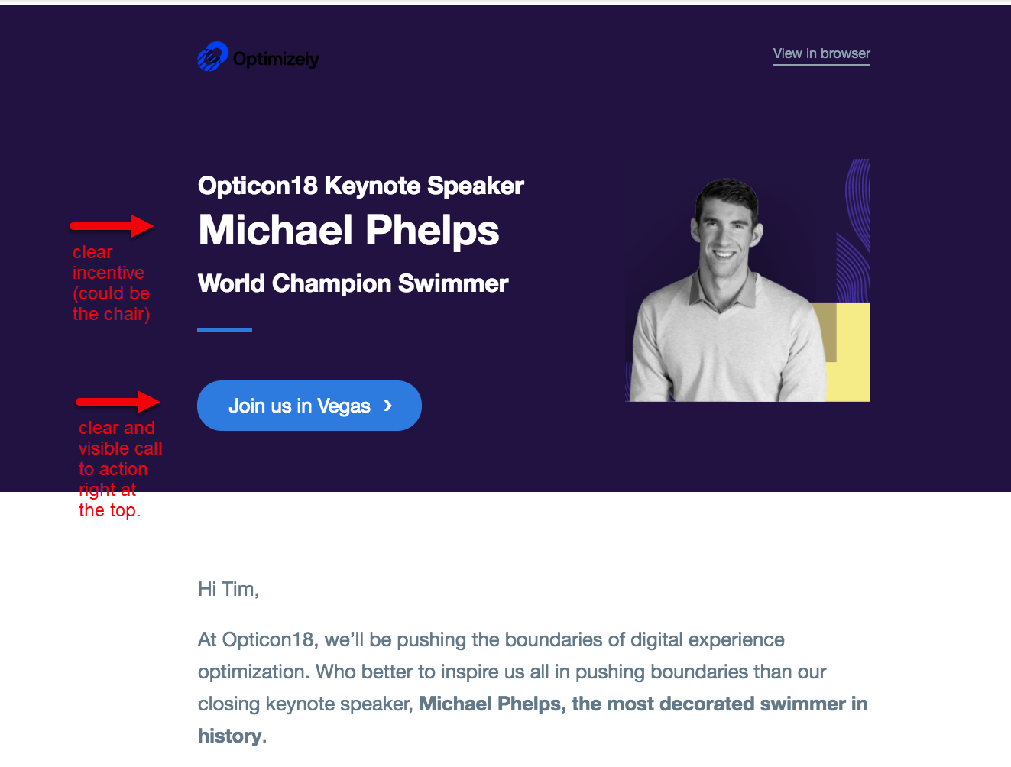
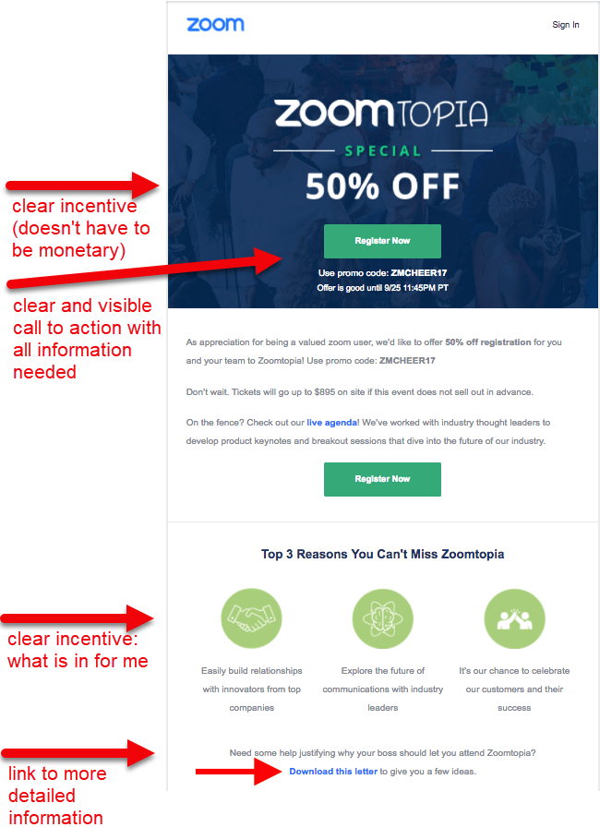
E-mail best practice
AO Trauma event promotion portal
Successful e-mail examples (3rd party)

Slide 5
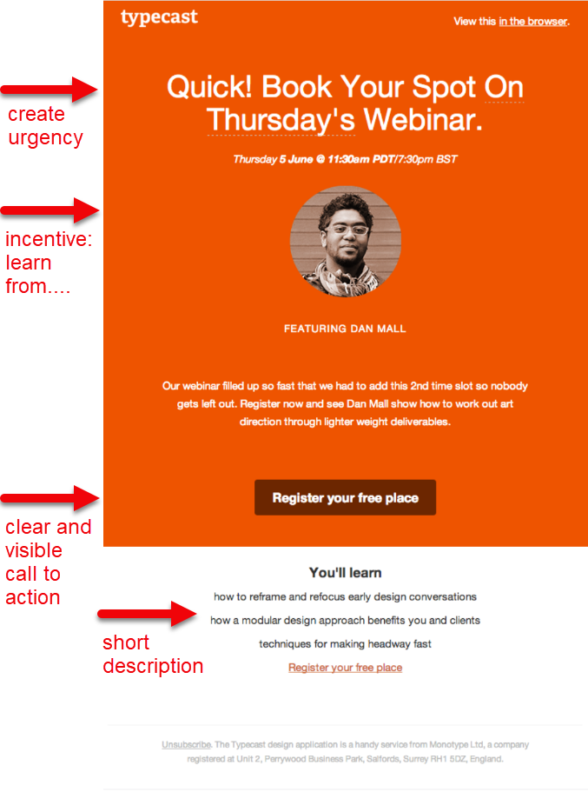
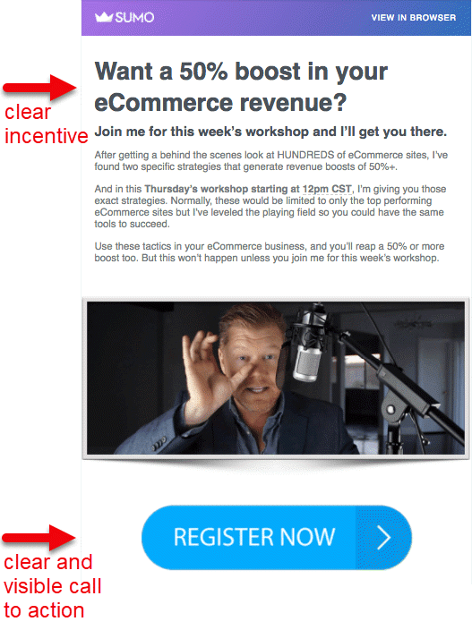
E-mail best practice
AO Trauma event promotion portal
Successful e-mail examples (3rd party)

